Slide 1
Orange County Wildfire Risk Assessment SSCI 581 Fall 2017
Chase VanSchoonhoven

Slide 2
Introduction
As of September 11th 2017 Calfire has reported 5,102 wildfires with approximately 230,000 acres burned.
The only wildland-urban interface fire code that does not have to do with building construction is a defensible space requirement of 30ft.
Goal of this study is to give policy makers greater knowledge when writing fire code for wildland-urban interface.
Study Area
Orange County California.
Although Orange County is densely populated, there are still many areas of low population, especially the eastern portion of the county where there are many regional parks.
High average temperatures and low precipitation leave the county vulnerable to wildfire year round.
.
SSCI 581 | 2
SECTION TITLE | 2

Slide 3
Data
Data Acquired
Name | Source | Format | Date of compilation | Attributes | Description
County Boundary | U.S. Census Bureau https://www.census.gov/geo/mapsdata/data/cbf/cbf_counties.html | Vector (Line) Shapefile | 10/19/2017 | Area | Orange County Boundary which covers the area of the study
DEM | USGS​ ​3DEP​ ​product https://viewer.nationalm ap.gov/basic/#productS earch | Raster Image | 08/2017 | 1 meter resolution elevation data | Elevation data that will be used to find the slop and aspect.
USGS GAP Data | USGS https://gapanalysis.usgs.gov/gaplandcover/ | Raster Image | 2011 | 30 meter resolution land cover data. | Plant communities and density.
Natural Gas Pipelines | EIA https://www.eia.gov/maps/layer_info-m.php | Vector (Line) Shapefile | 03/2017 | Location and distance of pipeline | Line data of natural gas pipelines.
Population Density | U.S. Census Bureau https://www.census.gov/geo/maps-data/data/tiger-data.html | Vector (Polygon) Shapefile | 12/05/2016 | Population | Shows the population density within Census Bureau tracts.
Transportation Infrastructure | https://ocdata.giscloud.com/ | Vector (Line) Shapefile | 2017 |  | Arterial, Street, Freeway, and Railroad Center Lines for Orange County
SSCI 581 | 3
SECTION TITLE | 2

Slide 4
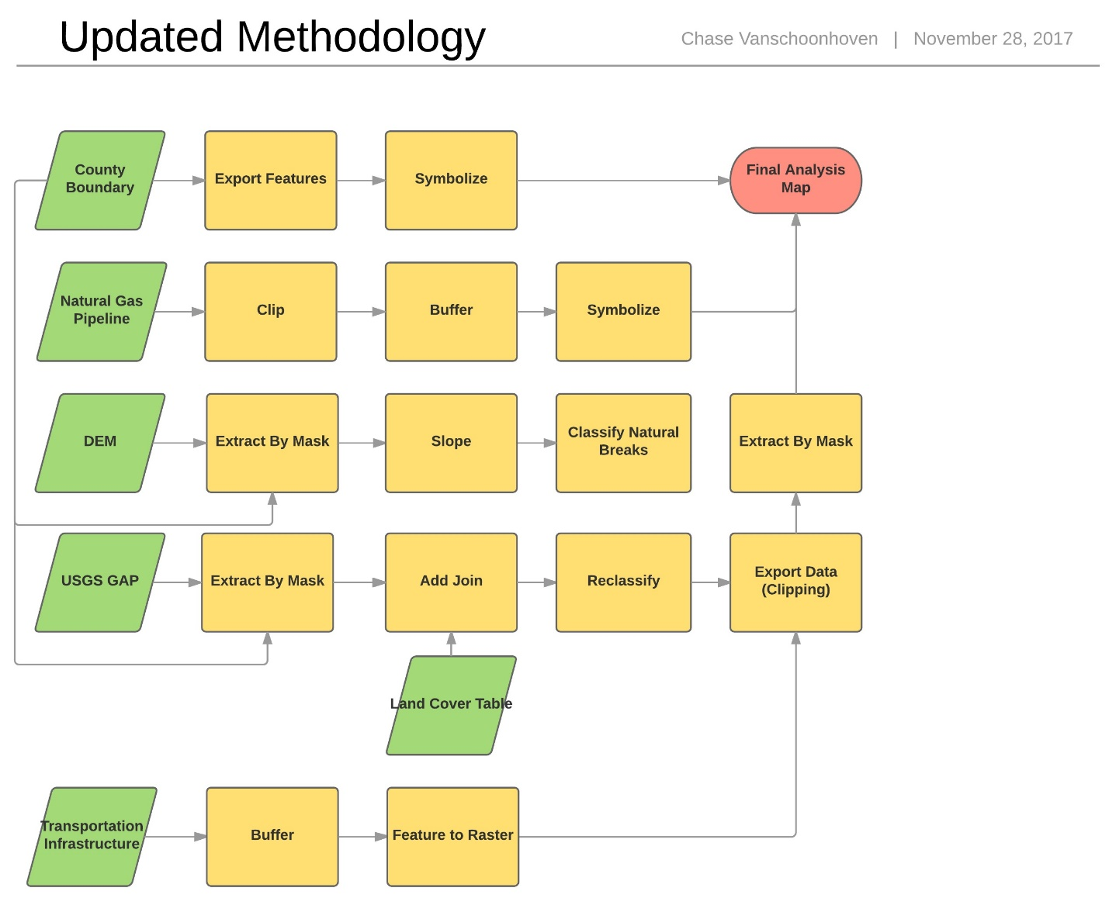
Methodology
SSCI 581 | 4
SECTION TITLE | 2

Slide 5
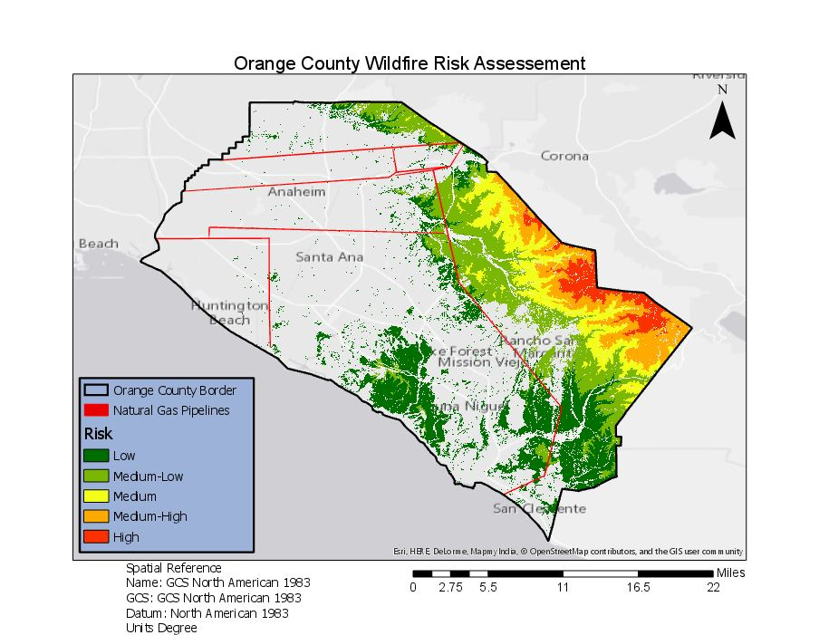
Results
SSCI 581 | 5
SECTION TITLE | 2

